Slide 1

TRANSITION SLIDE (White on Maroon)
CS 5704 Lightning Talk

Slide 2

Progress Point
Team Code Wizards
Parth Bapat (bapatparth@vt.edu)
Vivek Joshi (vivekj@vt.edu)
Mihir Palyekar (mihirlahu@vt.edu)
Sushma Deegoju (sushmad@vt.edu)

Slide 3
Problem Statement

Slide 4
Software development projects require real-time communication and collaboration between multiple team members and departments.
Sending emails to everyone or arranging in-person meetings, is time-consuming and lack the ability to track updates and progress in real-time.
This leads to delays, misunderstandings, and subpar project outcomes.

Slide 5
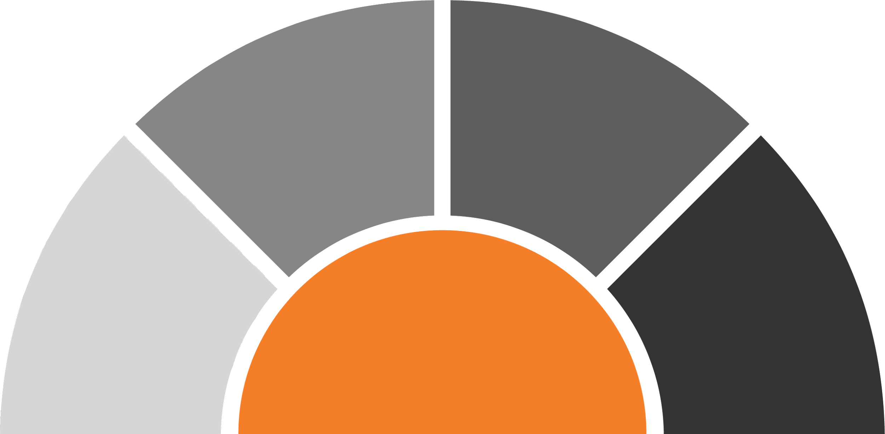



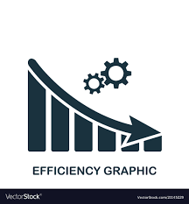


Impact of communication
Impacts product delivery timeline
Standups happen only
once a day
Creates a blocker to cross functional teams
Reduces developer efficiency
Lack of Communication
Notes:
Now why is this a problem?....We see the impact of lack of communication.
Standup meetings happen only once a day. If a team needs to convey their progress to other teams , they have to wait till the next standup. This creates a blocker to cross functional teams, leading to delays in product delivery timeline and reduced developer efficiency.

Slide 6
Progress Point Application
Progress Point is a centralized platform for teams to communicate and collaborate on software development projects in real-time.
Progress Point provide a solution by allowing software engineers to post updates, ask questions, and share information with the entire team in real-time, without having to switch between multiple tools.
It addresses the challenges faced by software teams in keeping track of each other's progress, sharing updates, and staying aligned on the project goals.

Slide 7
Use Cases

Slide 8
Use case 1: Subscribe the team members
Precondition: The software engineer has an account on the Progress Point and is part of a software development team.
Main Flow:
The software engineer logs in to the application.
The engineer navigates to the "Team" section and selects the team member they want to subscribe to.
The engineer clicks on the "Subscribe" button.
Subflow:
If the engineer wants to unsubscribe a member, they can select the team member, and click on the "Unsubscribe" button.
Alternative Flow:
If the team member is not listed, the engineer should check if they are part of the same software development team or not.

Slide 9
Use case 2: Sending task updates
Precondition: The software engineer has an account on the Progress Point and is part of a software development team.
Main Flow:
The software engineer logs in to the application.
The engineer writes a new update about the task in the text area or post images or designs using “post image” icon.
The engineer clicks the "Send" button.
Subflow:
If the engineer wants to edit or delete their update, They can then click on the "Edit" or "Delete" button.
Alternative Flow:
If user do not have any subscribers, his updates cannot be seen by them.

Slide 10
Use case 3: Reacting to task updates
Precondition: The software engineer has an account on the Progress Point application. The engineer has received an update from a teammate.
Main Flow:
The software engineer logs in to the application.
The engineer selects the message and clicks on the "React" button or “comment” button to send reaction.
The engineer clicks the "Post" button.
Subflow:
If the engineer wants to edit or delete their reaction or comment, they can then click on the "Edit" or "Delete" button to make the desired changes.
Alternative Flow:
The engineer cannot comment on the posts of the users he is not subscribed to.

Slide 11
Applications
Real-time updates and status tracking:
Software engineers can use the application to post real-time updates on their tasks.
Collaborative problem-solving:
When a software engineer runs into a difficult issue or bug, they can use the application to reach out to the team for help.
Cross-functional collaboration:
In many software development projects, multiple teams are involved.
The Progress Point can provide a platform for cross-functional collaboration, allowing team members from different departments to communicate, share information, and stay aligned on project goals.
Notes:
Other team members can provide suggestions, share relevant information, and work together to resolve the issue in real-time, reducing the time it takes to find a solution.

Slide 12
Relevance
This platform allows software engineers to share real-time updates, ask questions, and receive notifications, all in one place.
It provides a efficient and effective way for software engineers to communicate and collaborate which results in increased transparency, improved communication, and better collaboration between team members, ultimately leading to faster project completion times and higher-quality software.
This way the application promotes teamwork and collaborative effort between software developers and aids their day-to-day activities.

Slide 13
Questions?

